Slide 1
The Gold Notifyer
Be the first mover
Team
Max Sheng (University of Toronto)
Jace Gao (University of Toronto)
Sumit Arora (DAC Group)
Nitika Arora (Region of Peel)

Slide 2


Can Barrick have a facebook of mines?
Similar data
Easy to track with instant notifications
Structured data
Similar format
Easy to Track
Selective notification capability
Disparate data
Hard to track updates
Unstructured data
Different formats
Hard to track
Multiple people looking at similar data

Slide 3
Product Workflow
Scraping TSX – AUX
(every 15 mins)
ETL PROCESS (ML, Custom ranking function)
User Logs onto Map interface to view articles related to an area
User Select an area of interest and saves the subscription
User Gets emails and slack notifications
User clicks links to view the surrounding area

Slide 4
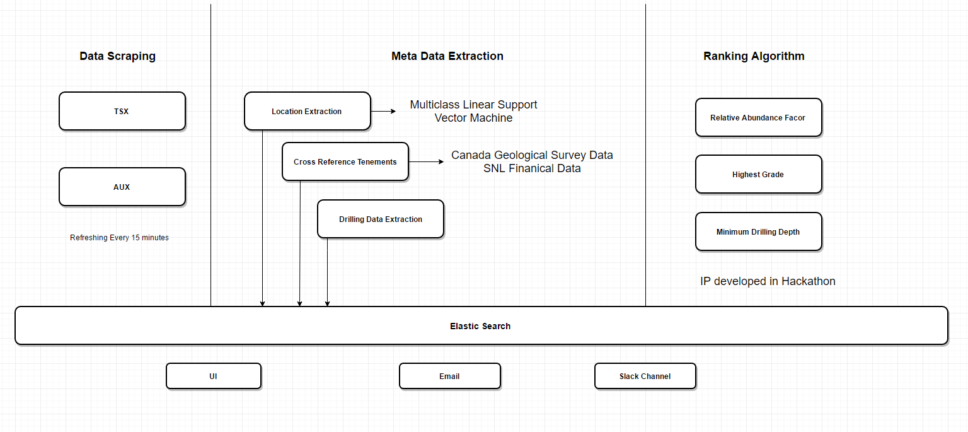
Solution Architecture

Slide 5
Demo

Slide 6
Roadmap
Additional scraper plugins
Custom Google like searches on elastic database
Tenenment data from other countries

